Slide 1
Twitter Data Analytics using Power BI
Internship Report
By: Fathima Riza
NullClass
Date: 17/09/2024

Slide 2
Introduction
During my internship at NullClass, I had the opportunity to engage deeply with data analysis and visualization, focusing on social media metrics. Over the course of 1 month, I was responsible for analyzing tweet performance through various visualization tasks using Power BI. This report provides an overview of the key projects completed.

Slide 3
Background
NullClass is an innovative EdTech company based in Bengaluru, India, founded by Vetri Selvan and Ansh Aditya in 2019. Specializing in online, project-based IT learning programs, NullClass offers a platform designed to provide students with hands-on experience in IT fields. The company's offerings include courses that enable learners to build practical applications such as mobile games and classified apps.
The internship program at NullClass provided an opportunity to apply data analysis and visualization skills to real-world challenges, specifically focusing on social media metrics and performance analysis.

Slide 4
Learning Objectives
Master Power BI: Learn to use Power BI for creating visualizations like pie charts, scatter charts, and bar charts.
Analyze Data: Develop skills in analyzing tweet metrics and applying filters to extract meaningful insights.
Filter Data Effectively: Understand how to apply time-based and content-specific filters to focus on relevant data.
Solve Real-world Problems: Enhance problem-solving skills by tackling practical data challenges.

Slide 5
Tasks
1. Build a pie chart that represents the proportion of total clicks (URL clicks, user profile clicks, and hashtag clicks) for tweets with more than 500 impressions. Include a drill-down to view the specific types of clicks for each tweet 2. Plot a scatter chart to analyse the relationship between media engagements and media views for tweets that received more than 10 replies. Highlight tweets with an engagement rate above 5% and this graph should work only between 12 PM to 6 PM and the tweet date should be odd number as well as tweet word count be below 50. 3. Analyse tweets to show a comparison of the engagement rate for tweets with app opens versus tweets without app opens. Include only tweets posted between 9 AM and 5 PM on weekdays and this graph should work between 12 PM to 6 PM and the tweet impression should be even number and tweet date should be odd number as well as tweet word count be below 40.

Slide 6
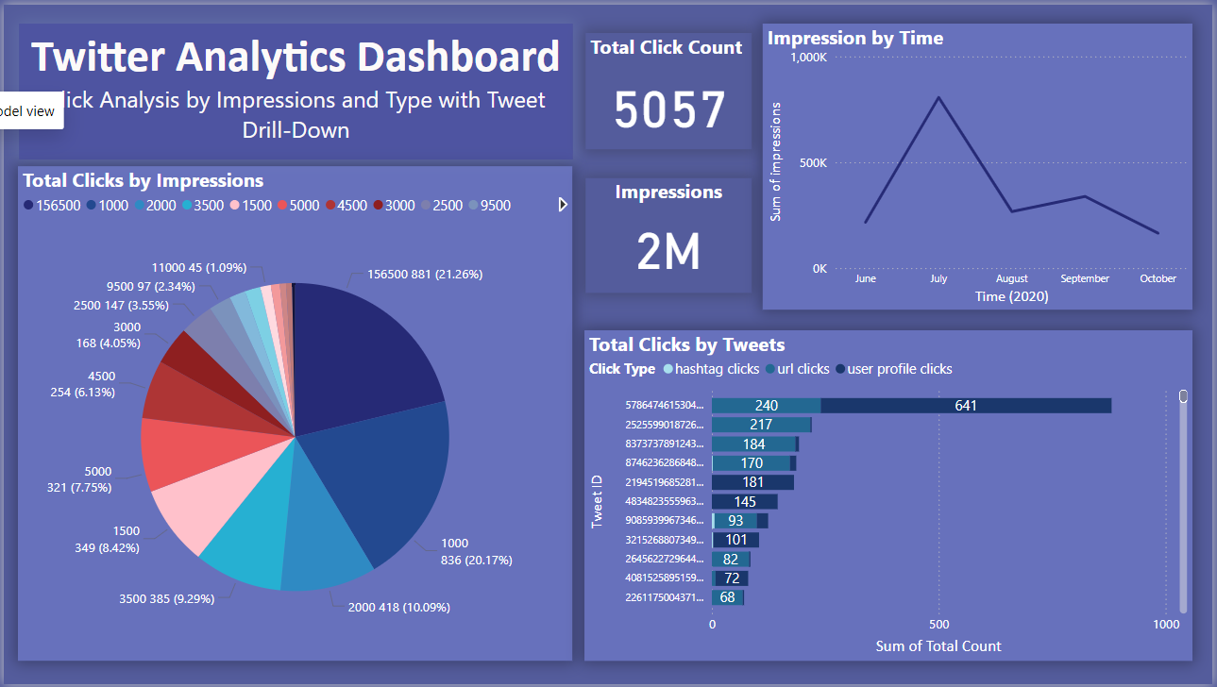
Activites and Task
Task 1: Pie Chart for Click Proportions
Objective: Analyze the proportion of total clicks (URL, profile, hashtag) for tweets with over 500 impressions.
Outcome: Created a pie chart with a drill-down feature to view specific click types for each tweet. Added cluster bar and line graph to improve the visualization of the pie chart.

Slide 7
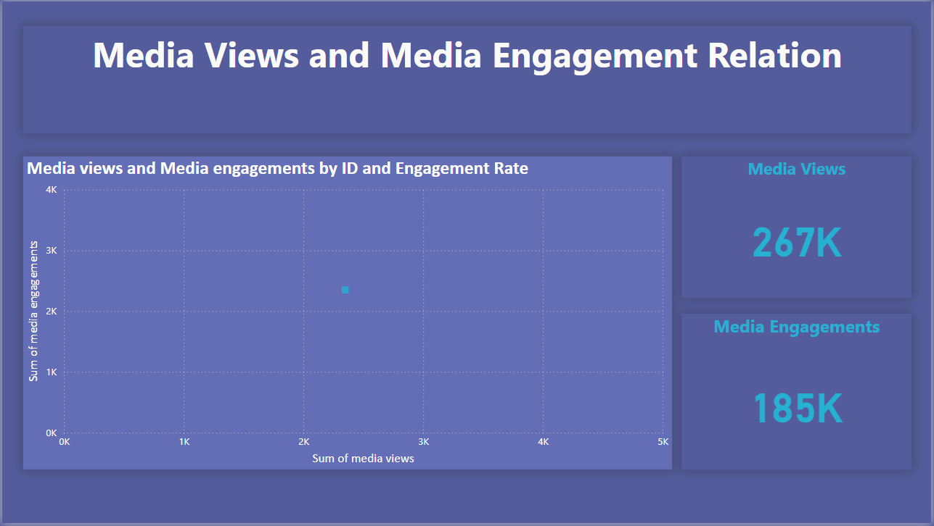
Activites and Task
Task 2: Scatter Chart for Media Engagements vs. Views
Objective: Explore the relationship between media engagements and views for tweets with more than 10 replies.
Outcome: Developed a scatter chart highlighting tweets with engagement rates above 5%, with data filtered to show only tweets between 12 PM and 6 PM, on odd dates, and with fewer than 50 words.

Slide 8
Activites and Task
Task 3: Clustered Bar Chart for Engagement Rates
Objective: Compare engagement rates for tweets with and without app opens, focusing on tweets posted between 9 AM and 5 PM on weekdays.
Outcome: Created a clustered bar chart with filters for even impressions, odd tweet dates, and fewer than 40 words, with dynamic content working between 12 PM and 6 PM.

Slide 9
Skills and Competencies
Technical Skills:
Proficient in Power BI for data visualization and analysis.
Applied DAX queries for advanced data filtering and calculations.
Created dynamic reports with real-time updates and multiple filters.
Analytical Skills:
Analyzed tweet engagement data to uncover insights.
Developed an understanding of key social media metrics, such as impressions, clicks, and engagement rates.
Problem-Solving:
Addressed challenges like handling filtered datasets and creating time-based visualizations.
Optimized data models to enhance report performance.
Communication:
Presented data-driven insights through clear, concise visualizations and reports.
Developed skills in summarizing complex data for easy comprehension.

Slide 10
Challenges and Solutions
Challenge: Complex Data Filtering
Solution: Utilized DAX to create custom filters for time-based and content-specific constraints, ensuring only relevant data was displayed in the visualizations.
Challenge: Dynamic Time-bound Visuals
Solution: Implemented dynamic measures and filters to ensure the graphs only display data within specific time frames (e.g., 12 PM to 6 PM), meeting project requirements.
Challenge: Handling Data Constraints
Solution: Devised strategies to filter data based on multiple conditions, such as impressions being even, tweet dates being odd, and word counts below a certain threshold.

Slide 11
Outcomes and Impact
Improved Data Insights:
The visualizations provided deeper insights into tweet engagement patterns, helping identify trends in media views, engagements, and app opens.
Enhanced Reporting Efficiency:
The dynamic filtering and custom visualizations made reports more actionable, allowing users to focus on relevant data with ease.
Real-World Impact:
The analysis contributed to refining social media strategies, enabling better understanding of engagement drivers and areas for improvement.
Personal Growth:
Gained valuable experience in data analysis, report creation, and problem-solving, which will be applicable in future roles and projects.

Slide 12
Feedback
The internship provided an excellent opportunity to develop my skills in data analytics and become proficient in using Power BI for real-world tasks.
I gained a solid understanding of how to create effective visualizations, apply complex filters, and analyze data for meaningful insights.
Working on real-world projects helped me understand how data analytics is applied in a professional setting. It also gave me exposure to the dynamic working environment, improving my ability to manage tasks and meet deadlines.
Screenshots of the Power BI visualizations created during the internship, including pie charts, scatter charts, and clustered bar charts.

Slide 13
Conclusion
The internship at NullClass allowed me to enhance my data analytics skills, particularly in using Power BI for real-world projects. I gained practical experience in creating visualizations and analyzing data, which improved my understanding of the professional environment. This experience has been valuable for my career development, equipping me with essential skills for future roles in data analysis and reporting. I would like to thank NullClass for providing me with this opportunity.

Slide 14
Thank You

